Slide 1
Endsem presentation- DEEP LEARNING
NOTES MAKING OR TEXT EXTRACTION APP
TEAM - 13

Slide 2
TEAM MEMBERS
P.GUNA VARDHAN – CB.EN.U4AIE22145
J.P.N.SREESANTH – CB.EN.U4AIE22125
y.SUDHEER KUMAR CHOWDHARY – CB.EN.U4AIE22151
d.VIKYATH – CB.EN.U4AIE22115

Slide 3
INTRODUCTION
Navigating the future

Slide 4
introduction
The "Hand Gesture-Based Notes Making" project introduces an innovative application that allows users to create notes using simple hand gestures in front of a webcam. This interactive system leverages state-of-the-art computer vision and deep learning techniques, including MediaPipe, OpenCV, and TensorFlow, to identify and interpret specific hand gestures that correspond to actions commonly performed in digital note-taking. The primary goal of this project is to provide an intuitive, hands-free interface for creating and editing notes, making it especially useful for people looking for accessible, interactive, and real-time writing solutions.

Slide 5
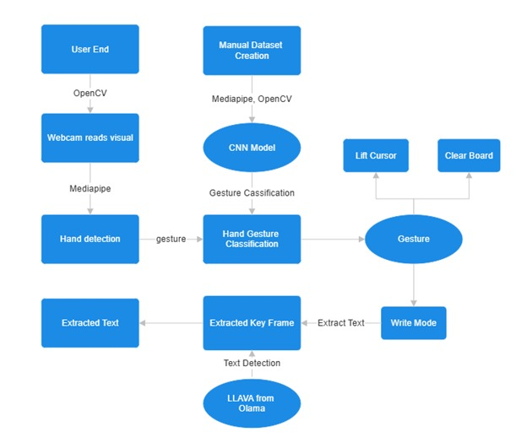
WORKFLOW

Slide 6
DATASET CREATION
Unlocking new horizons

Slide 7
Dataset creation
Q3
CAPTURE THE HAND USING MEDIAPIPE’S HAND MODEL
Q4
NORMALIZE AND SAVE THE IMAGES AND CHECK FOR ANOMALITIES
Q1
INITIALISE THE SIGN
Q2
FIX THE NO OF IMAGES

Slide 8
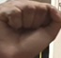
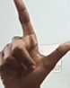
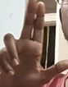
CLASSES

Slide 9
ARCHITECTURE
Navigating the future

Slide 11
MODEL TRAINING
CNN-MODEL

Slide 12
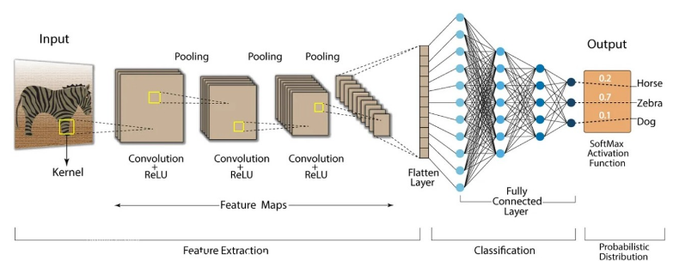
CNN
Input - 128X128X3
3 conv layers
Flatten layer
Fully connected
Dropout
Output – 3 neurons

Slide 13
CNN
FLOW (Input – 128 x 128 x 3)
Conv2D Layer 1:
Operation: Convolution with 32 filters
of size (3, 3) and ReLU activation
Input: (128, 128, 3)
Output: (126, 126, 32)
Conv2D Layer 2:
Operation: Convolution with 64 filters
of size (3, 3) and ReLU activation
Input: (63, 63, 32)
Output: (61,61,64)
Conv2D Layer 3:
Operation: Convolution with 64 filters
of size (3, 3) and ReLU activation
Input: (30, 30, 64)
Output: (28,28,128)
MaxPooling2D Layer 1:
Operation: Maxpooling with (2,2) with a stride of 2
Input: (126, 126, 32)
Output: (63,63, 32)
MaxPooling2D Layer 2:
Operation: Maxpooling with (2,2) with a stride of 2
Input: (61,61, 64)
Output: (30,30, 64)
MaxPooling2D Layer 3:
Operation: Maxpooling with (2,2) with a stride of 2
Input: (28,28, 128)
Output: (14,14,128)

Slide 14

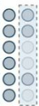
CNN
FLOW (Input – 128 x 128 x 3)
Flatten Layer:
Operation: Converts the 3D feature maps to 1D vector.
Input: (14,14,128)
Output: (25088,)
Dense Layer:
Operation: Fully connected with 128 neurons and ReLU activation
(Wi.Xi +bi) – 25088 weights
Input: (25088,)
Output: (128,)
Dropout Layer:
Operation: Prevents overfitting by randomly setting 50% of neurons to 0
Input: (128,)
Output: (128,)

Slide 15
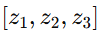
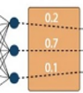
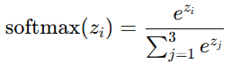
CNN
FLOW (Input – 128 x 128 x 3)
Each of the 3 neurons computes weighted sum of 128 inputs, adds a bias. - Logits
Softmax converts logits into probabilities with sum =1.
Output Dense Layer:
Operation: Fully connected layer with 3 neurons and softmax activation for multi-class classification
Input: (128,)
Output: (3,)
Logits
Softmax Activation
Output

Slide 16
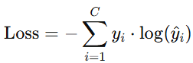
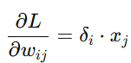
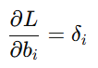
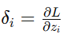
CNn
Backpropagation -
Loss Function –
Backpropagation computes the gradients, and the optimizer uses these gradients to update the weights
(Categorical Cross-Entropy Loss)
1. Dense Layer Gradients
Equation
i -> i’th neuron (in the layer) j -> j’th input
yi -> actual label
(1 if the class is correct, 0 otherwise)
Wij -> weight in the i’th neuron corresponding to the j’th input
y^i ​-> predicted probability for class
loss with respect to the output 𝑧𝑖 of the neuron.
Model’s prediction is compared to the actual label.

Slide 17
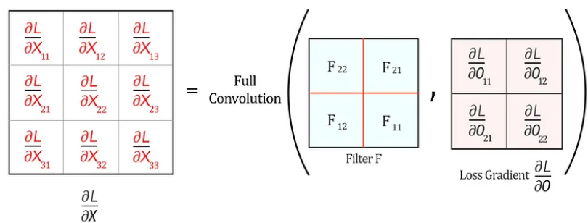
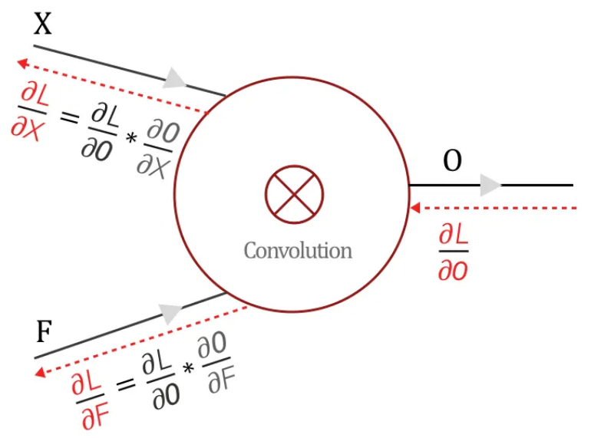
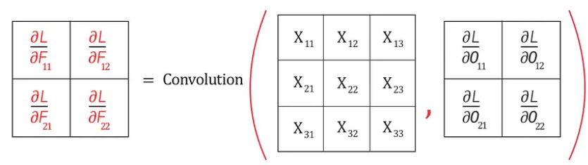
CNN
BACKPROPAGATION
2. Convolutional Layer Gradients

Slide 18



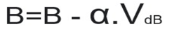
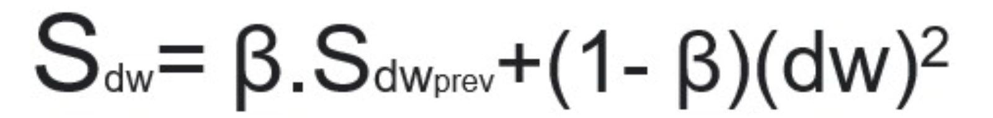
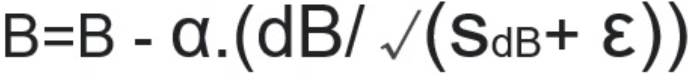
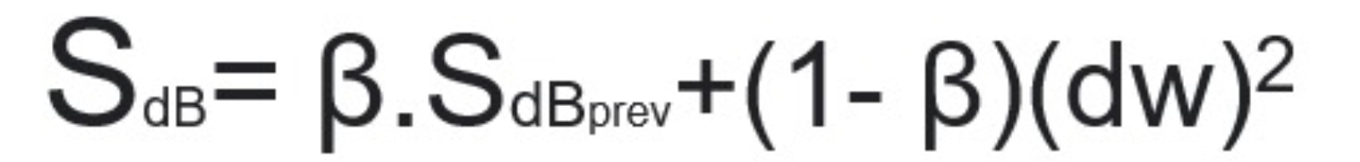
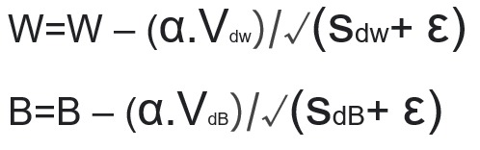
CNN
Optimizer – (Adam)
Weights update
1. Momentum
1. Momentum
2. Root Mean Squared Propagation (RMSP)
2. Root Mean Squared Propagation (RMSP)
Adam
α is the learning rate.

Slide 19
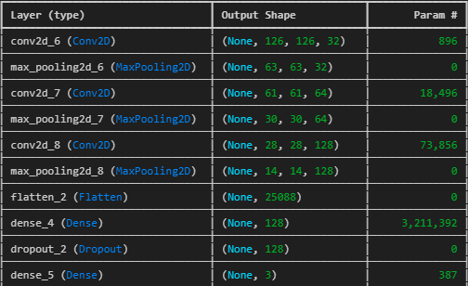
ARCHITECTURE

Slide 20
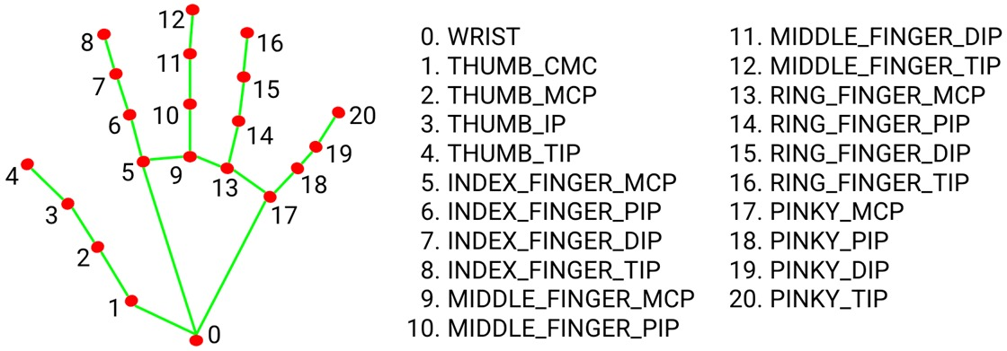
Mediapipe landmarks

Slide 21
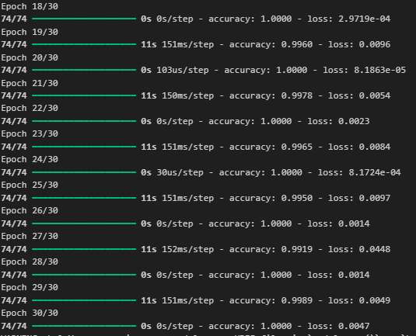
TRAINING

